Slide 1
The Jan-San Omnichannel Imperative
Executive Conference August 26-29, 2019

Slide 2
Agenda (Questions to Live Into)
Not Business as usual ideas; i.e., best practices, fine-tune past
Seizing a Paradigm change: end-user, digital-value creation
Back-Cast Amazon Business 2022? Defend? Beat regulars?
Be like Digital Disruptors: Business (channel) Model Innovations?
Omnichannel Imperative
Fewer, better e-selling Reps for B2B Millennial buyers?
‘80’s: drug-wholesale transformation including reps
Why - Showrooming, Webrooming and Clone-SKUs – Win?
Solve Cross-Subsidies within your channel before going digital?

Slide 3
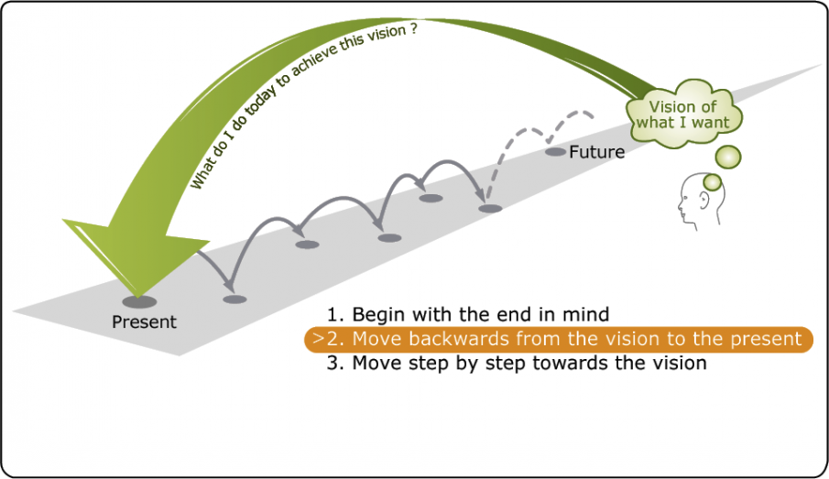
Back-Cast to Innovate Forward?
Open-minded to: New Paradigms? Vocabulary, concepts?
Forecasting v Back-casting
Back-Cast to evolve Best, Right Questions to Live Into.
Answers emerge. Then, experiment; fail/learn forward
Typical Forecasting?
Incremental improvements
Fine-tuning what has been
Fine if no external changes
Great White Shark ➔ Gator
400MM years of evolving
New model for the swamp?

Slide 4
“Omnichannel Imperative”?
Omnichannel: provide “e- buying journeys” for digital B2B End-Users
Match “AMZ experience” profitably; without clickstream incomes?
Imperative?
AMZ owns next-gen eyeballs and first search
Search big brand/SKU; clones appear! Pay for AMZ Brand Registry?*
Digital Content Mgt + journey? Info-video + pts? 24/7 chat? Buy it now?
“Protect” legacy channel “partners”; and/both, digital-reality solutions?
Mimic Disruptors: do Business/Channel Model Innovations (BMIs)?
* Ultimate Guide to Amazon Advertising by Seward (April, 2019)

Slide 5
Envision AMZ-BIZ in August ‘22?
4/15 to 12/31/18: Zero to $10B. Long-tail (x) resellers➔ Clickstream
Continuous Innovations:
Supports 60+ procurement integrations
Central-spend-management cloud tools (AWS workarounds!)
0 to 20% of MRO spend at: universities, hospitals, govt’s
Australian government. US GSA contract; lobbyist stall
Not (yet) threatening contracts for bulky consumables, but:
(4/19) first truckload of paper via AMZ-BIZ (Central National)
(7/31) AMZCommercial: towels and tissue
Direct TL selling by marginal producers?
X-Dock cases/skids of Profitable Fat-Head SKUs?

Slide 6
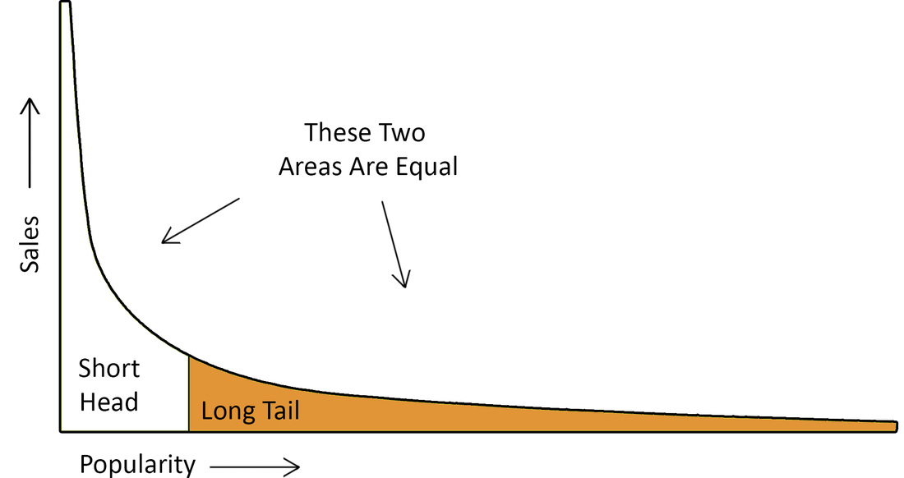
LONG-TAIL LENS STRATEGIES
AMZ Long-Tail for books
Gets Eyeballs
Discount Fat-Head, Big-$-Picks + Private Label
Popular Small Picks?
Bundle
Add-on
Raise prices
Minimize losses
Walmart X-Docks 7% of SKUs that are 70% of their sales
Biggest consumables
Private labels
99% fill, no excess
Low/No promotions
@Every Day Low Prices

Slide 7
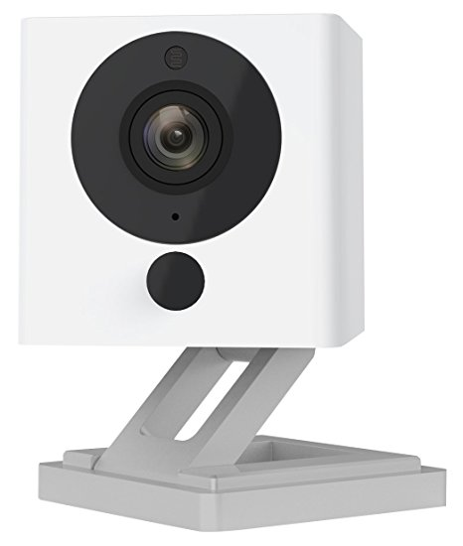
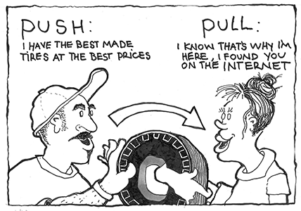
AMZ Can’s v Can’ts (New dynamic equilibriums?)
Spot-buy of shoppable goods that fit its capabilities
11+, Winner-take-all, integrated platforms for 3PL fees
Low-Cost @ each step + macro, cloud, AI, inventory-flow
Brand Accelerator clones (Wyze Cam). Barriers?
AMZ Can’t do: e-integrated, sole-supply systems
How much Shift from Push-Marketing to Pull?
List of SKUs AMZ hasn’t hit yet?

Slide 8
AMZ Resistant SKUs (so far). 50% of Retail and…
Customer specific products (special-printing, fab in-house)
General processing, converting, assembling, kitting, equip. repair
Exclusive (?), unique brands…not commodity clone-able
Bulky, low-quality freight?! + Special delivery equipment. (Coke; fuel)
Products requiring personnel for: training, blueprint takeoffs, repairs
System replenishment contracts: design, install, tune, maintain
Sold through consignment and vending
Frozen, cold chain
Regulated: alcohol (?), tobacco, drugs (?)
Others? Rank percent of SKU sales from most to least vulnerable.

Slide 9
How Disruptors’ Skim? Business-Model Innovations (BMIs)
Digital Disruptors attacking all buying journey experiences
Find “pain points/friction” at initial buying journey steps
Resolve with off-the-shelf: cloud, digital-selling tools and BMIs!
Offer Total-Category + search attributes, reviews, etc. v. Your site?
Then, creep back the Customer Value Chain towards suppliers
Amazon: Doorstep-to-Global-Producers
jet.com order incentives x Best SKUs; 3PL services for fees (SuperValu by ‘86)
5. Control eyeballs, clickstream to monetize. Suppliers (resellers) pay!
Who is guilty of going to Digital-Disruptor, category-sites first?

Slide 10
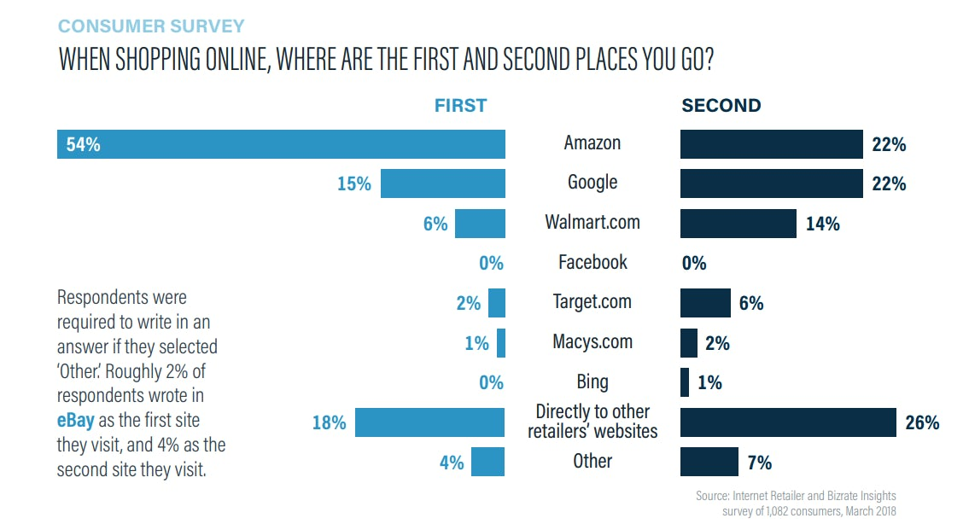
90% Check AMZ Before Buying Elsewhere
Millennials #1 APP? AMZ!
E-integrate Key
Customers

Slide 11
Exponential, Product – Info, Pricing – Effects?
Exposes Showroom-able SKUs
Disruptors have lower, fulfillment costs for spot buys (e.g. no rep costs)
Clones with 5-star reviews for 50% less (no - channel, shelf space - barriers)
600 AMZ exclusive brands (many Chinese, outsource producers)
If distributor gets last look to meet a price?
Profit hit. Still have losing SKUs, customers; higher, service-cost model
BMIs from other channels?
Super-Valu by ‘86; Drug channel ‘80’s (chain-store union + bar code catalyst)
Key accounts: “e-integrated (1-stop) sole supply” (custom, open-book, 3PL)
Small-Losers? Web-sell on profitable terms with order-size incentives

Slide 12
Root Causes for - Showrooming, Clone - Wins?
Retailers: Showroomed (Best Buy 2012)
Distributors: get web-roomed.
Lose spot-buys on net-profitable SKUs by low-cost customers.
Grainger’s 2% sales decline with 25% profit decline (Q1, ‘17)
Cut prices to keep volume (like Best Buy), but still less profitable.
Same if you get last-look to match on-line prices
Answer:
Cross-subsidies within channel-model exploited

Slide 13
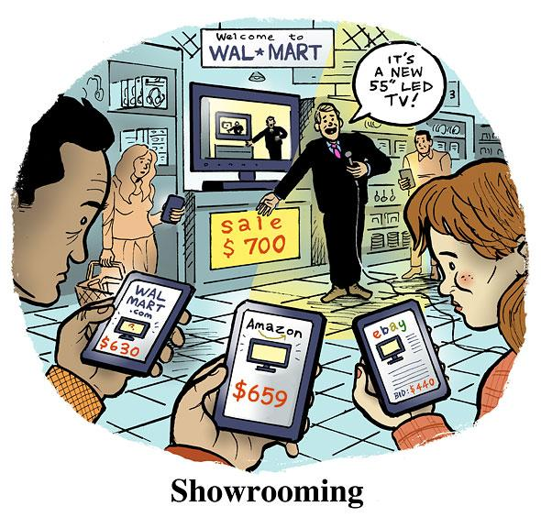
Margin-Myopia Blind Spots
Channel Mark-ups (e.g. 20-35%)
Turn (x) Earn: financial metric
Blind to: order-size and
Cost-to-Serve dollars (CTS$s)
GM$s per pick/line in popular:
High-priced, shopped SKUs @ 20%
Low-priced, blind SKUs @ 50%
Profit Equation Management?*
GP$s (less) CTS$s (equals) Profit$s
Unbundled, order-size BMIs?
* PEM? A follow-up webinar?

Slide 14
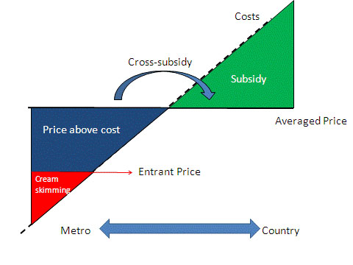
Cross-Subsidies: Fix Them or Get Creamed
UPS v USPS;
ATT v MCI, etc.
Distributors’ Cross-Subsidies
Amongst Customers
Amongst SKUs/Vendors
Popular Big $-Picks v Small
Brands: vanilla + 31 flavors?
Listerine (625); Equate (25)
Aldi 3000 v Full-Service 50K
Amongst Sales Territories
Directs v Counter unless:
Fastenal store prices/model

Slide 15
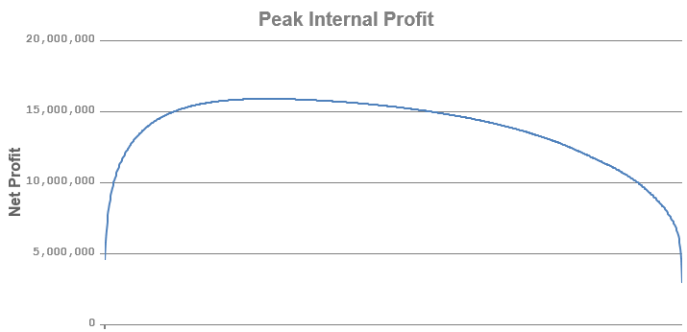
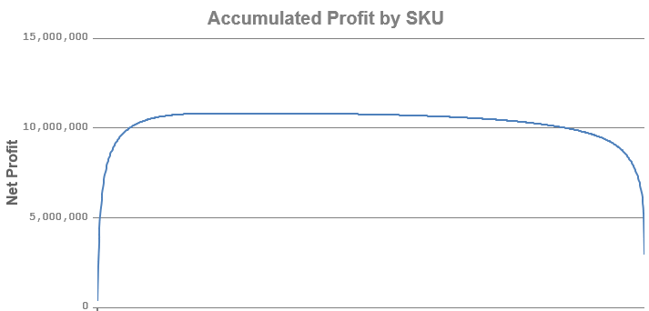
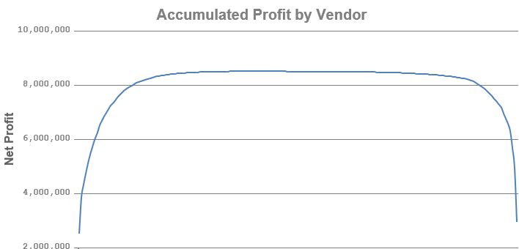
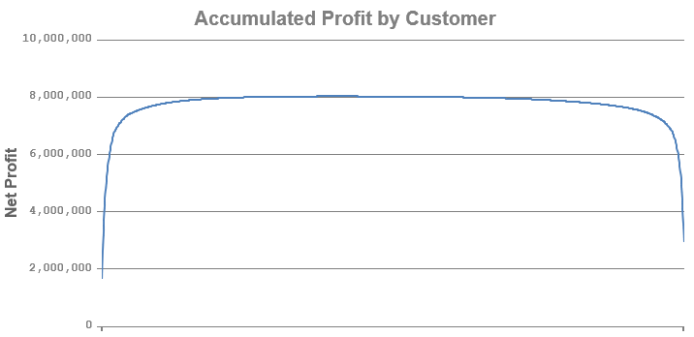
Distributor Whale Curves*
PIP:$15.5MM
PIP: 10.5MM
Every Line Item P/L plotted
SKUs’ P/L Plotted
(LEAST ACTIONABLE)
PIP: 8.5MM
PIP: 8MM
Every Vendor’s
P or L Plotted
Customer WC
MOST ACTIONABLE
Intersection, cream-buys
lost Initially to AMZ: 2/20+ Hit to Profits
*Customer Profitability Analytics with a Profit Equation for every line-item/pick
Each curve has all line-item profit equations included. All tail points equal PROFITS

Slide 16
Profit-Equation Management Discoveries
Losing-Element Stats (innumeracy challenges?)
70% of lines; 62% orders; 30-60% customers; 20-50% territories
5% of warehouse SKUs big winners v. 5% are big losers (hi-pick, small-$)
Vendors of top 5, winners. Bottom 5%, losers with high GM%
SSWA members are often net-profit losing vendors for distributors!?
Top-5%, Profit Customers: Huge! Wholesalers and distributors…
Audit to tune-up, retain, win more spend
3% perpetual innovators. Partner them, they grow you. Consolidators?
Wholesalers and Distributors should first do: CPA Renewal ?

Slide 17
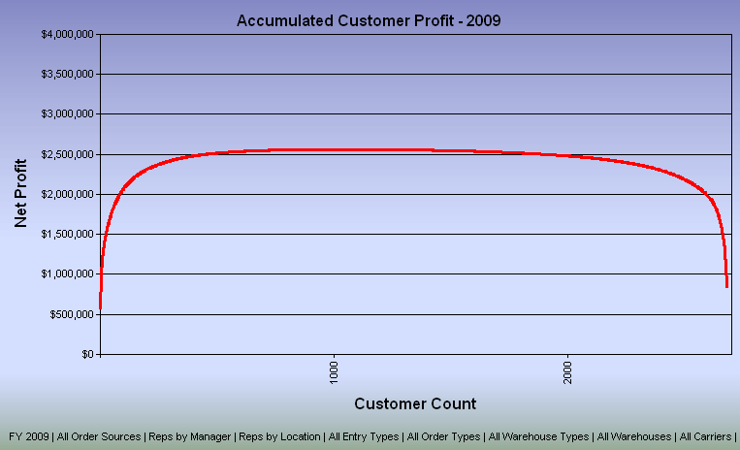
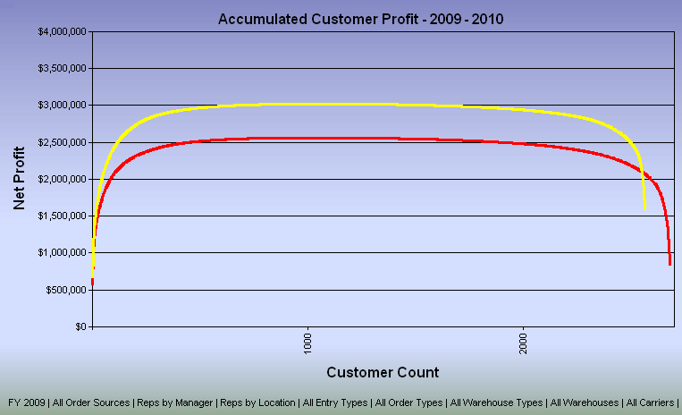
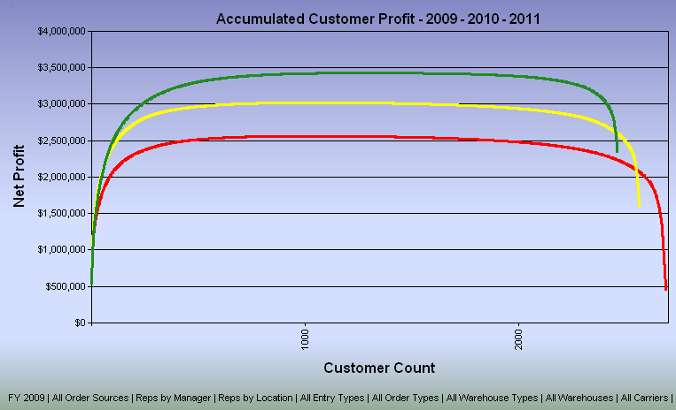
Customer Whale-Curve; New-Play Results over 24 Months
2
7) 5X in 2yrs
Bonuses for All
3: many small losers
6) Eventual Goal: “100% of Customers (quickly) Profitable” to look like?
4
5
2) 10% customers ➔ 500% Profits
4) 1% of customers eat 40% of profits

Slide 18
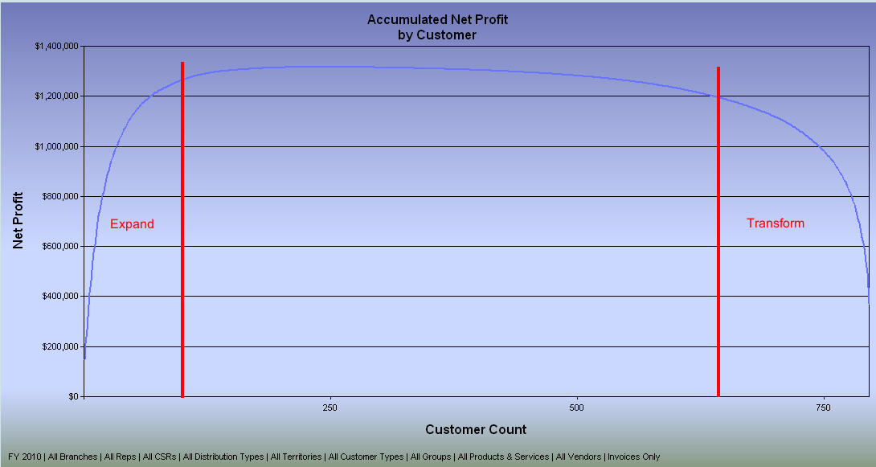
Customer Whale-Curve: Begs for 3-4 Different “Service (cost) Models”
(Customer Niche Clusters?)
Peak internal Profits
4. Minnows: Wholetail Service-cost Model 40-80%
2.----- Standard 19-15%
Lose-Lose to Win-Win 1-3%
➔ Enterprise or Standard
(3. Direct Brokerage: Division; Rep(s)?)
1. (Team) Enterprise 1-5%
Tail-end sums to P&L’s
Operating profit.
(See slides on “Enterprise Selling Model” at the end)

Slide 19
Jan-San-Channel Players Assumptions:
Many Brands must create digital connections to B2B end-users
AMZ? Or, “vertical marketplaces” that out niche AMZ’s “everything”?
SKU analytics to unbundle, re-bundle channel and business models?
How many wholesalers/distributors will: fade, fold, sell?
Historic stats: process change wipes out 85% of old model players.
3% of mature businesses are perpetual innovators: “Gazelles”
Ambitious wholesalers, distributors both need to:
Do a customer-profitability renewal and partner top 5%
Then, start failing/learning forward to e-beat legacy competitors

Slide 20
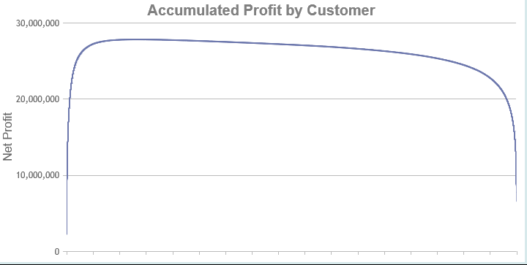
Not SEO Web-Selling!
$300MM Distributor’s Web Division:
Doubled (new) customers
Bottom 81% of customers
4.8% of GP$s; 26.2% invoices
Lost (9.8MM)
Not AMZ’s low-cost + clickstream
Opportunity cost with Bigs?

Slide 21
Cross-Docking Utility for Fat-Head SKUs?
Like Ikea, it is a supply-chain, integrative business-model
Combines:
CoLinx: 3PL factory coop with no data-sharing
PTPlace: Colinx’s companion Order Entry Site
Jet.com dynamic pricing for cases-on-the-way (or in-stock)
Dead-net pricing with fintech payment (distributors would backhaul)
Cross-Dock pre-ordered cases/skids
Or, what will AMZ invent? “The Everything Store” is “relentless”
“Bartering different containers of commodities globally” Jeff Bezos

Slide 22
Closing Thoughts
AMZ-Biz and/or Direct and X-Docking sellers will skim cream
Traditional Field Sales Model will fade
Customer-centric (not rep-centric) BMI necessity
Your e-selling-reps vision? Fewer, better, higher-info, e-interacting?
Get Service-cost analytics to:
Partner best customers, fix losers
And, unbundle, re-bundle new models
Live and Experiment into the Right Questions
Would welcome follow-up, in-depth webinars (?)

Slide 23
Questions
Extra Support Slides

Slide 24
AMZ’s Value-Chain Platforms: Unique, Critical-Mass, Aggressively-Evolving, Digital-Scaling
Prime Members. (“sanity check”; 500+ metrics)
Own best 60% of US households + Clickstream-Fuel, Virtuous Cycle
AI Bots do 30% More-Selling and Improving!
Marketplace: 2MM; 450MM SKUs; 100% (redundant) fill-rates.
(AMZ-BIZ going for Long-Tail SKUs and 100% B2B, next-gen buyers)
Best Web Site experience (most easily copied)
JIT, Product Info:
Resellers: curate SKUs (x) dynamic pricing for commodities and oddities
Reviews
Video, Content Mgt. war amongst brands by 2020

Slide 25
AMZ Platforms (2)
5. Fulfillment by Amazon (FBA): low-cost; execution; scalable
Last-mile metrics (+) Innovations (SWA, drones, etc.)
Home Depot’s pre-emptive 170 new DCs? 40: flatbeds to job sites (?)
7. Global Supply Chain for All ➔ AMZ Basics + Accelerator (Wyze Labs)
AWS: standalone platform biz.
Co-Creating cloud commerce with startups. 5G streamer (Netflix)
Engine for: AMZ platforms; Washington Post; Whole Foods ➔ Platform APIs
Workarounds: MRO spend; Partners/Tires; doctors; pharmacists; ???
9. Alexa….Voice Commerce; IoT, smart-home and office
10. 5G video APIs; Reward Pts; FinTech; Loans;

Slide 26
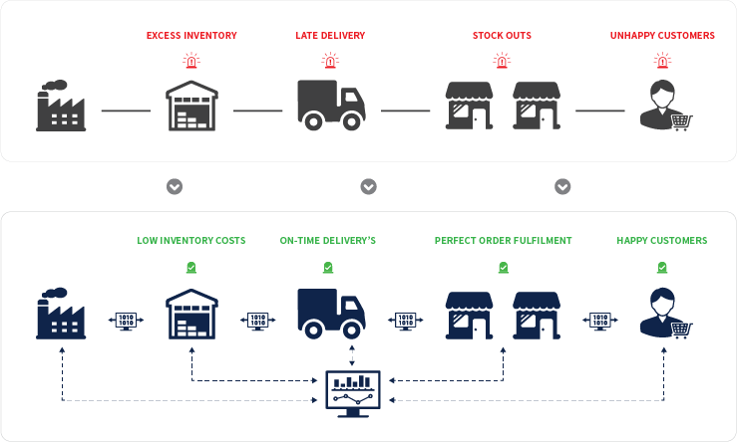
Your - Pull, JIT, Cloud Supply Chain – Strategy?
Product
Push
Load Up
Vision Stages:
1. Better web site!?
2. Customer-back, digital value tools
3. Rethink business in the Cloud from Millennials’ phone
Customer
Pull, JIT
Digital, Interactive, Real-Time, Cognitive, JIT-Pull Demand, Paperless, People Expertise as needed 24/7

Slide 27
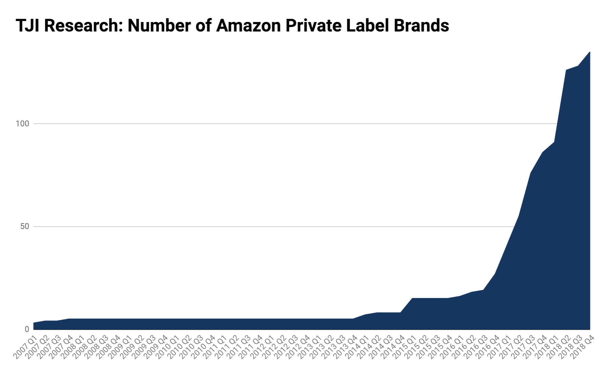
3-19-19: Marketplace Pulse Report
135 AMZ + 271 Excl Partners = 406 Brands
20 Categories
23K+ SKUs
Most new, selling little (?)
Will weed; no predation; resellers?
Seeding New Platform:
“Global Supply Chain by Amazon”

Slide 28
Ultimate Guide to Amazon Advertising by Seward (pub. 4/19)
SOME KEY POINTS:
AMZ 1.0 is now 2.0; Big upside. Still sleepy, big Brands
Field Guide x Scientific Experiments to Piggyback AMZ Machine
Optimize sales in all channels. 50%++ Searches at AMZ first, then…
Tools/steps for getting MAP compliance within months
Amazon Brand Registry to lock down and control all Digital Content
See how Amazon Echo appears in total.
Resellers of other’s brands = race to bottom, losing game
Do resell dust collectors and close outs (used books; flex pricing)

